Slide 1
Intelligent Summarization of Website Content Using Transformer-Based Models.
Final Year Project – Review 2
Project Supervisor Details
Ms.R.Divyabharathi,M.E.
Assistant Professor
Department of AI and Data Science
Team Members
M.GOPINATH-8208E22ASR020
B.THARANIBALAN-8208E22ASR060

Slide 2
Problem Statement
Websites today are not only text-based – they also include images, videos, and audio (like podcasts or interviews).
Users spend a lot of time reading long articles, watching videos, or listening to audio to understand the main idea.
Existing summarization systems mainly focus on text-only content.
But images, videos, and audio also carry important meaning (example: an image of a farmer spraying crops explains more than 5 lines of text).
Therefore, there is a need for a universal summarization system that can combine text, images, video, and audio into one short and meaningful summary.

Slide 3
Objective
To develop a system for summarizing multimodal web content.
To extract text, images, and video data automatically.
To preprocess and structure extracted web data.
To generate summaries using the Text-to-Text Transfer Transformer.
To convert images into text using the Bootstrapping Language-Image Pretraining.
To transcribe video audio using Whisper.
To integrate outputs from multiple modalities.
To improve summary accuracy and coherence.
To reduce user time and effort in understanding content.

Slide 4
Base Paper Details
Title: BLIP: Bootstrapping Language-Image Pre-training for Unified Vision-Language Understanding and Generation
Authors: Junnan Li, Dongxu Li, Caiming Xiong, et al.
Year: 2022
Publication: Proceedings of ICML (International Conference on Machine Learning)
Research Scope: Develops a vision-language model to understand images and generate text using large-scale multimodal data.
Findings: The Bootstrapping Language-Image Pretraining performs well in image captioning by aligning visual and textual features.
Future Directions: Extend models to full multimodal systems combining image, text, and video for advanced summarization tasks.

Slide 5
Existing System
Text-Based Summarization Systems: Focus on extracting and summarizing textual content using extractive or abstractive techniques from Natural Language Processing.
Rule-Based and Statistical Approaches: Use predefined rules and statistical methods like keyword frequency and TF-IDF to identify important sentences.
Machine Learning-Based Summarization: Apply algorithms such as SVM and Naïve Bayes to learn patterns and rank sentences based on features.
Deep Learning-Based Models: Use neural networks like RNN, LSTM, and transformers to generate context-aware and meaningful summaries.
Single-Modality Processing Systems: Process only one type of data (mainly text) without integrating images or video content.

Slide 6
Proposed Work
The proposed system presents an intelligent approach for summarizing multimodal web content by integrating text, image, and video data into a unified framework. It uses advanced AI models to extract, process, and combine information from different modalities, producing a concise and meaningful summary.
Multimodal Data Processing using AI Algorithms: Uses Text-to-Text Transfer Transformer for text, Bootstrapping Language-Image Pretraining for images, and Whisper for video transcription.
Multimodal Fusion and Summary Generation: Combines outputs from all modules and refines them using Text-to-Text Transfer Transformer to generate a final unified summary.

Slide 7
Literature Review
No | Paper Info | Methodology | Algorithms | Dataset | Merits | Demerits
1 | “Exploring the Limits of Transfer Learning with a Unified Text-to-Text Transformer”, Colin Raffel et al., 2020 | Unified NLP framework for text summarization | Text-to-Text Transfer Transformer | CNN/ DailyMail | High-quality abstractive summaries | Limited to text-only data
2 | BLIP: Bootstrapping Language-Image Pre-training”, Junnan Li et al., 2022 | Vision-language understanding and image captioning | Bootstrapping Language-Image Pretraining | COCO Dataset | Effective image-to-text conversion | Does not handle video/audio
3 | “Robust Speech Recognition via Large-Scale Weak Supervision”, Alec Radford et al., 2022 | Speech-to-text transcription for multimedia | Whisper | Multilingual Audio Datasets | High accuracy in noisy audio | Computationally intensive
4 | “BART: Denoising Sequence-to-Sequence Pre-training for NLP”, Mike Lewis et al., 2020 | Text generation and summarization using denoising techniques | Bidirectional and Auto-Regressive Transformers | CNN/DailyMail | Strong performance in text summarization | Limited multimodal capability

Slide 8
DATASET COLLECTION
🔹 Source
Kaggle – CNN/DailyMail Dataset
Real-time web data via scraping (text, images, videos)
🔹 Data Description
300,000+ articles with summaries
Features: Article, Highlights, Title, Author, URL
Multimodal: Text + Image links + Video data
🔹 Quality & Relevance
Human-written summaries (high accuracy)
Covers multiple domains (news, tech, health)
Well-aligned with web content summarization

Slide 9
Data Preprocessing
Steps Involved,
Removed null and duplicate values
Cleaned text (special characters, HTML tags, noise removal)
Performed text normalization (lowercasing, tokenization)
Extracted and structured image and video metadata
Converted data into model-compatible format
Tools/Libraries Used:
Python (Data handling)
NumPy, Pandas (Data processing)
BeautifulSoup, Requests (Web scraping)
Transformers (Preprocessing for models)
OpenCV / PIL (Image handling)

Slide 10
Future Work
Real-Time Processing
The system can be enhanced to support real-time content updates and instant summarization. This improves responsiveness for dynamic web pages and live data sources.
Multilingual Support
The system can be extended to process and summarize content in multiple languages. This increases usability for global users and diverse web content.
Model Optimization
Advanced optimization techniques can reduce processing time and resource usage. This improves efficiency and enables deployment in low-resource environments.

Slide 11
Model Development
1. Text-to-Text Transfer Transformer (Text Summarization)
Workflow:
Train model using article–summary dataset
Input text is tokenized and encoded
Model learns contextual relationships during training
During prediction, input text is passed to model
Model generates concise summary as output
2. Bootstrapping Language-Image Pretraining (Image Captioning)
Workflow:
Train model on image-caption datasets
Input image is converted into feature representation
Model learns mapping between image and text
During prediction, image is given as input
Model generates descriptive caption

Slide 12
Model Development
3. Whisper (Speech-to-Text)
Workflow:
Train model on large-scale audio-text dataset
Input audio is converted into spectrogram
Model learns audio-to-text mapping
During prediction, audio is processed
Model outputs transcribed text
4. Multimodal Fusion Model
Workflow:
Collect outputs from text, image, and video models
Align and combine all outputs
Remove redundant information
Refine combined data
Generate final unified summary

Slide 13
Drawback of Existing System
Focus mainly on textual data and ignore multimedia content
Unable to integrate text, image, and video information
Generate incomplete or less informative summaries
Lack contextual understanding of complex content
Depend heavily on manual feature engineering
Struggle with large and unstructured web data
Limited adaptability to different website formats
Inefficient in handling real-time data processing
Lower accuracy in capturing semantic meaning
Require high preprocessing efforts for clean data
Do not provide unified or comprehensive summaries

Slide 14
Model Implementation
Step 1: Collect website URL as input from user interface
Step 2: Perform web scraping to extract text, images, and video links
Step 3: Preprocess extracted data by removing noise and structuring content
Step 4: Apply Text-to-Text Transfer Transformer for text summarization
Step 5: Use Bootstrapping Language-Image Pretraining for image caption
generation
Step 6: Extract audio from videos and transcribe using Whisper
Step 7: Integrate outputs from all modalities using multimodal fusion
Step 8: Refine and generate final coherent summary
Step 9: Store results in database and display output to user

Slide 15
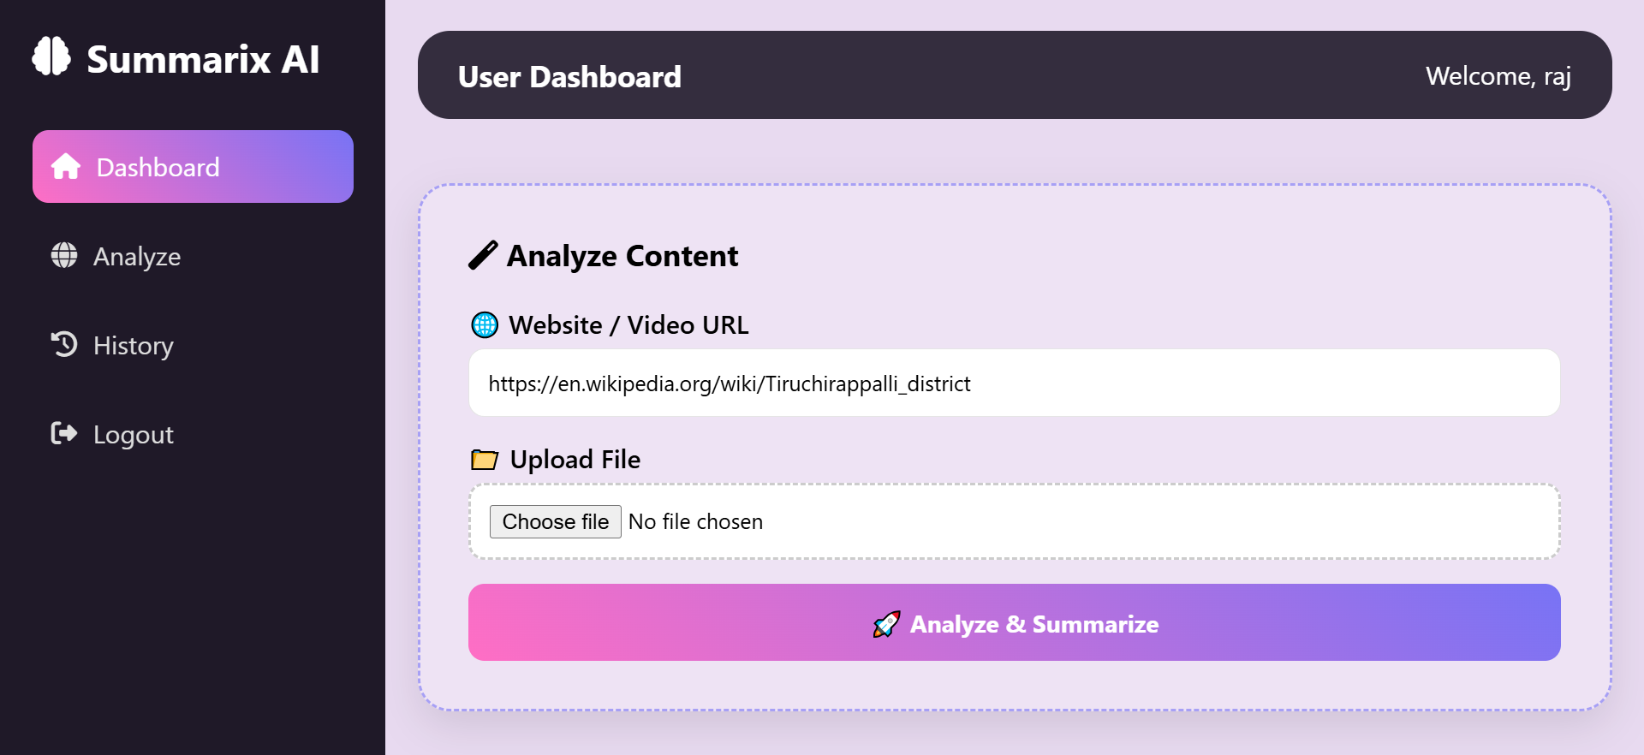
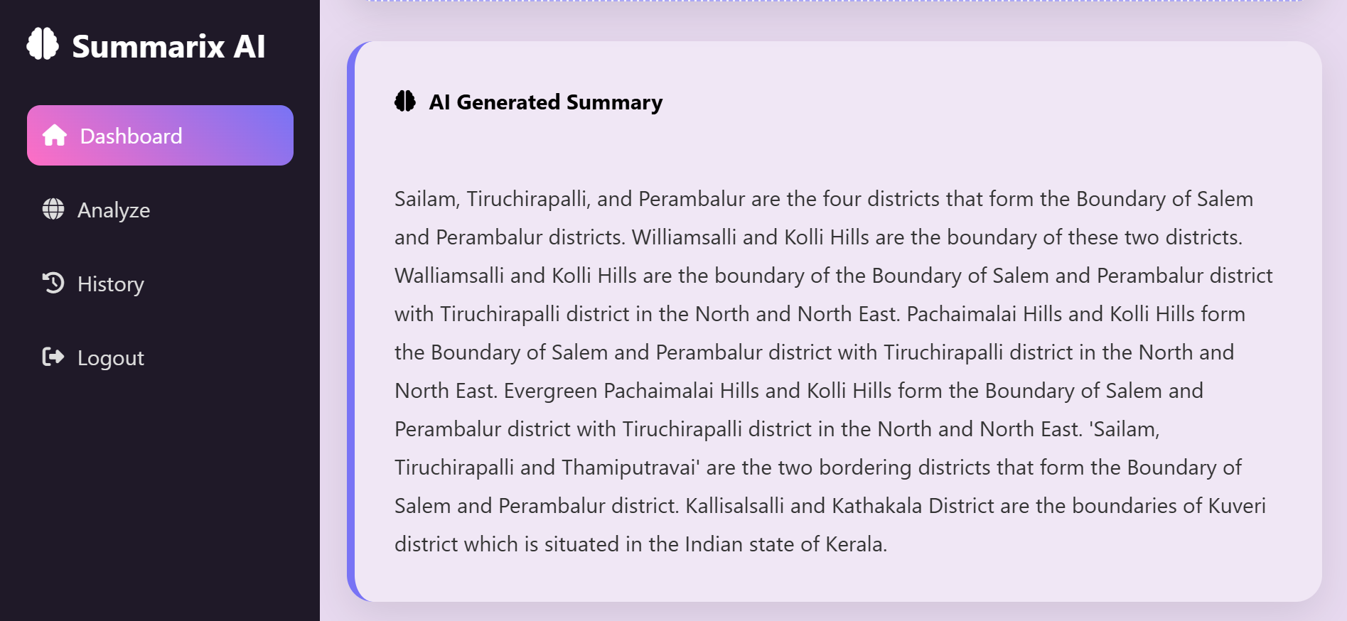
Deployment

Slide 16
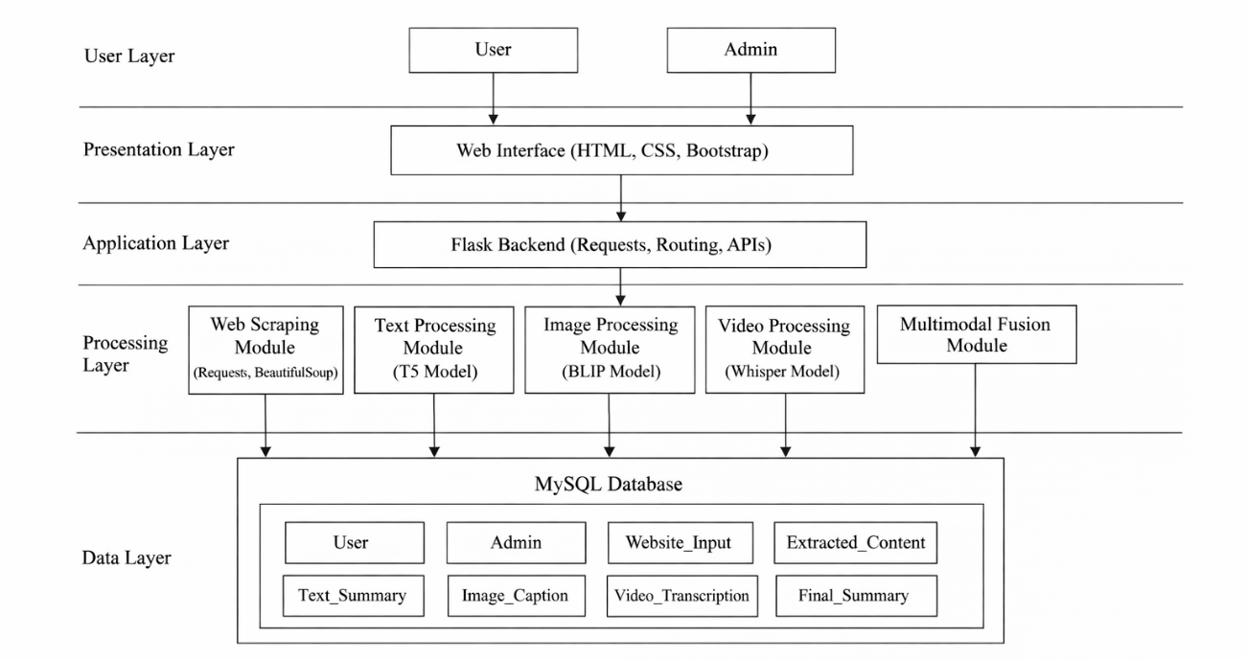
System Architecture

Slide 17
Conclusion
In conclusion, this project develops an intelligent system to summarize multimodal web content by integrating text, image, and video data. Using the Text-to-Text Transfer Transformer, Bootstrapping Language-Image Pretraining, and Whisper, the system generates accurate and concise summaries. It effectively reduces information overload and provides a scalable solution for efficient content understanding.

Slide 18
References
Colin Raffel et al., “Exploring the Limits of Transfer Learning with a Unified Text-to-Text Transformer,” Journal of Machine Learning Research, 2020.
Junnan Li et al., “BLIP: Bootstrapping Language-Image Pre-training for Unified Vision-Language Understanding,” ICML, 2022.
Alec Radford et al., “Robust Speech Recognition via Large-Scale Weak Supervision,” 2022.
Mike Lewis et al., “BART: Denoising Sequence-to-Sequence Pre-training for NLP,” ACL, 2020.
Jingqing Zhang et al., “PEGASUS: Pre-training with Extracted Gap-sentences for Abstractive Summarization,” ICML, 2020.
Ashish Vaswani et al., “Attention Is All You Need,” NeurIPS, 2017.
Jacob Devlin et al., “BERT: Pre-training of Deep Bidirectional Transformers for Language Understanding,” NAACL, 2019.

